Slide 1
All About Me
By: Tyler Scarborough

Slide 2
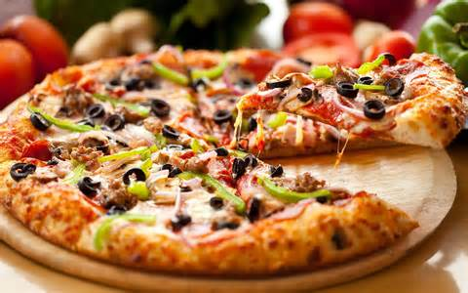
My Favorite Food
My favorite food is pizza because it is really good.

Slide 3
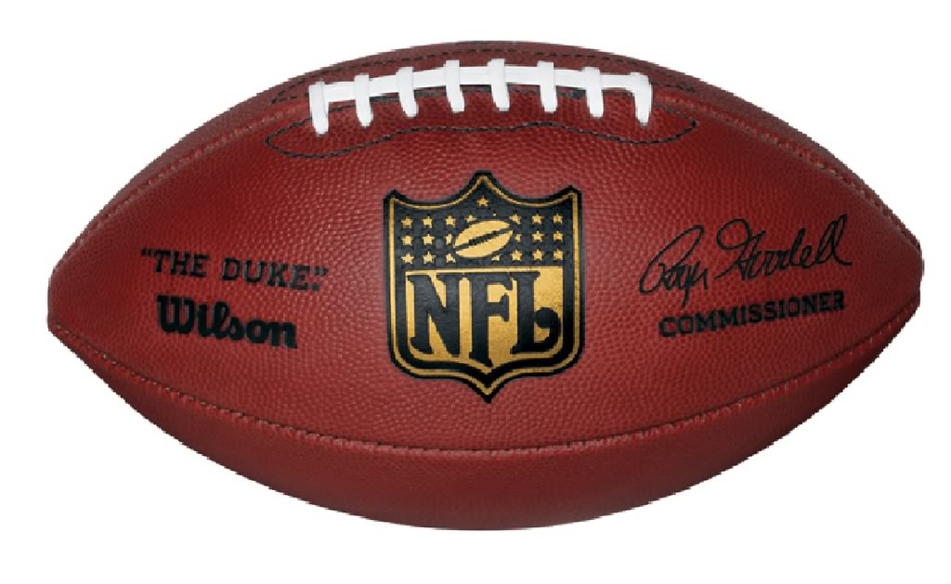
My Favorite Sport
My favorite sport is football because it is fun to play it when you are board.

Slide 4

My Favorite Team
My favorite team is Alabama because they are really cool football team.

Slide 5

My Favorite Movie
My favorite movie is Friday The 13th because is cool and scary.

Slide 6
My Favorite Place To Visit
My favorite place to visit is the park and the mall because they have fun and cool things to do.

Slide 7

My Favorite Color
My favorite color is Green because it is a cool color and it also is my dads favorite color.

Slide 8

My Favorite Holiday
My favorite Holiday is Christmas because I get cool things from my dad.

Slide 9
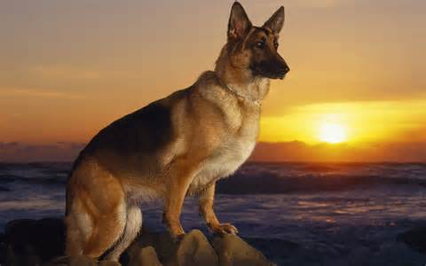
My Favorite Type Of Dog
My favorite type of dog is a German Shepard

Slide 10

My Favorite Character
My character is DeadPool.

Slide 11
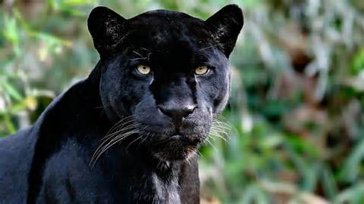
My Favorite Animal
My favorite animal is a Black Panther

Slide 12
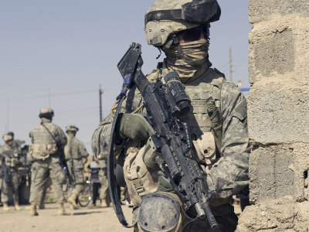
Future Career
My future career is going to the ARMY.

Slide 13
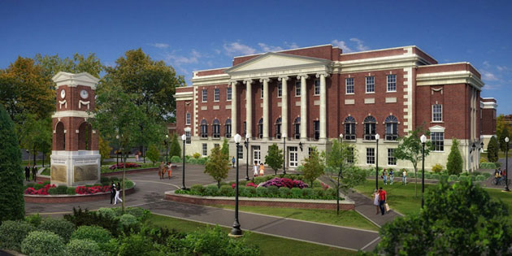
Future Plans
My future plans are going to collage and getting a good job.

Slide 14
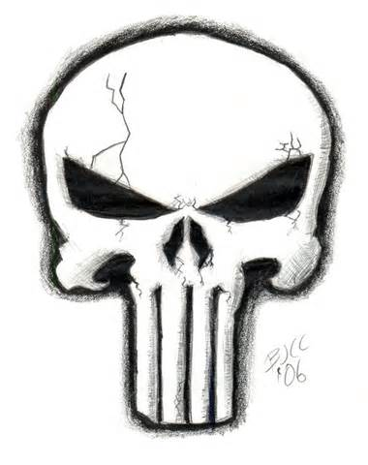
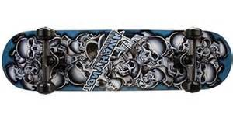
My Hobbies
Skateboarding
Drawing
I like riding my skateboard.
I love to draw with my dad.

Slide 15
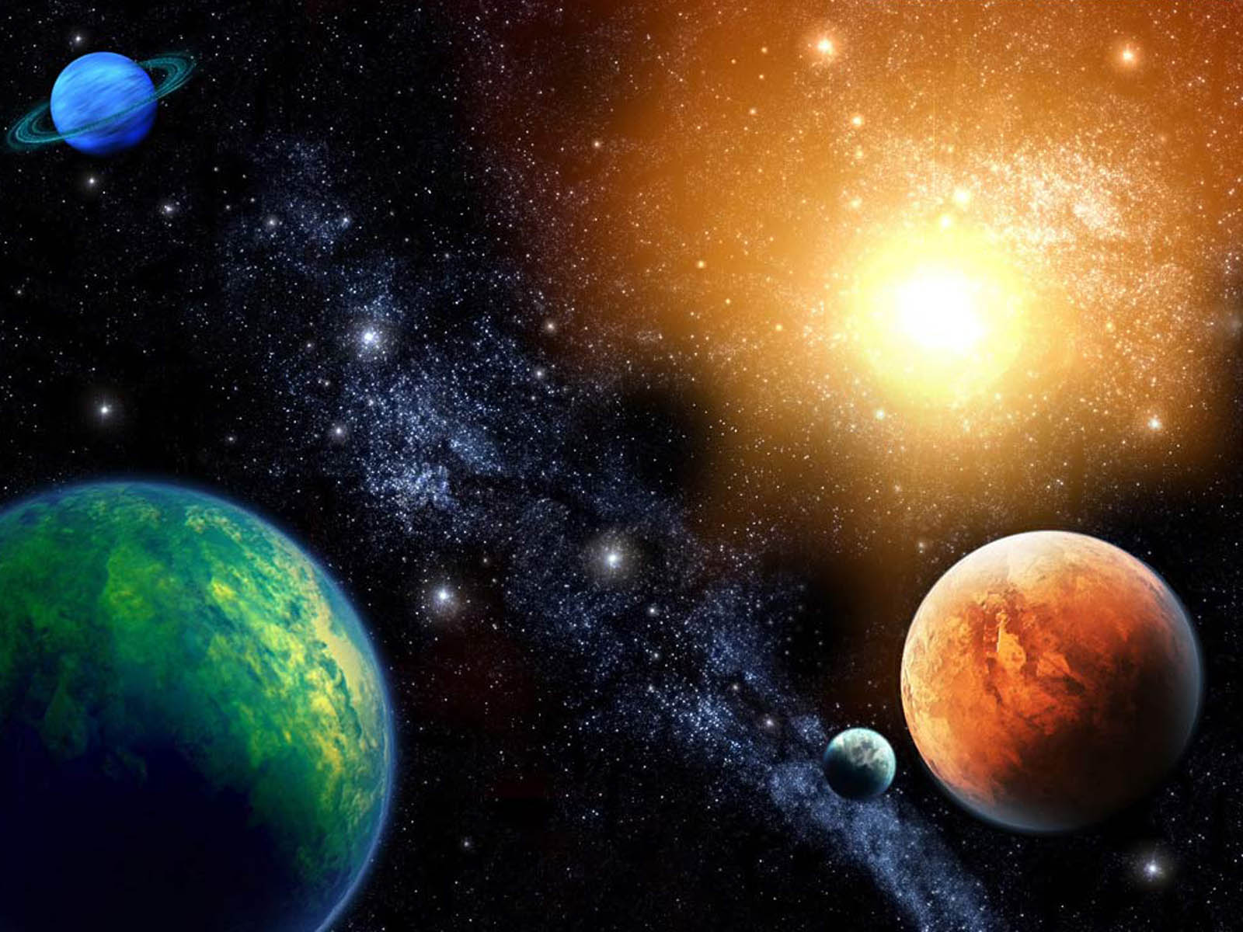
My Favorite Subject
My favorite subject is science because I get to look at the different types of stars and planets.

Slide 16
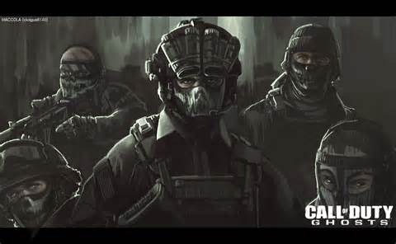
My Favorite Game
My favorite game is Call Of Duty Ghost.

Slide 17
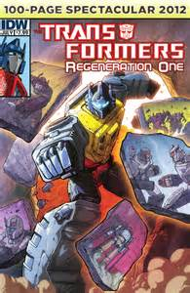
My Favorite Book
My favorite books are comic books.

Slide 18
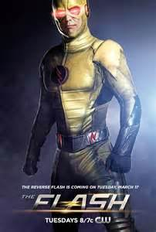
My Favorite TV Show
My favorite TV show is Flash.

Slide 19

My Other Favorite Team
My other favorite team is Colarodo Rams.

Slide 20

My Favorite Restaurant
My favorite restaurant is Burger King because they have really good burgers.

